Slide 1
ABC Electronics Sales Performance Analysis

Slide 2
Task 1 – Searching and filtering data
Format as table applied.
Filtering for the columns as given below:
Region: South
Product Category: Electronics
Date: 2023
Total of 196 orders were placed in the year 2023 in South Region for Electronics product.

Slide 3
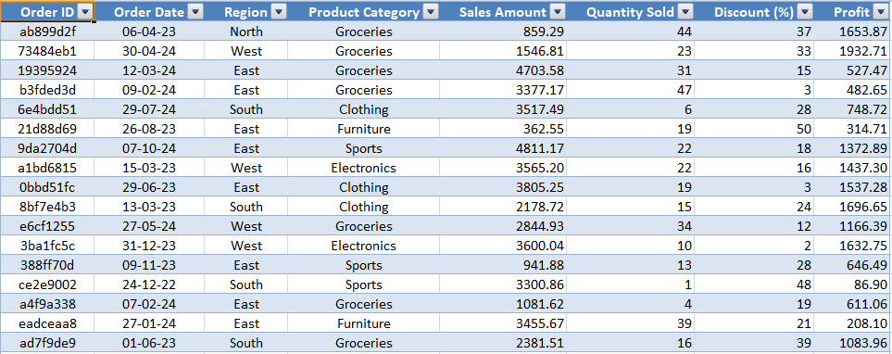
Task 2 – Data cleaning with text, upper and lower functions
Formulas such as =Trim(), =Upper, =Proper() were used to clean the data with additional spaces and arrange the text properly.

Slide 4
Task 3 – merging data
Average sales amount for each region was calculated with the formula =averageif() in the main dataset.

Slide 5
Task 4 – excel formulas
Total sales for each region calculated using formula =sumif()
Average discount percentage and profit for furniture category is computed using formula =if(criteria,average(),value if true, value if false).

Slide 6
Task 5 – pivot tables
Total sales and profit by region and product category using pivot table.

Slide 7
Task 6 – charts
Bar chart showing total sales for each region.
Pie chart showing the percentage contribution of each product category to total sales.

Slide 8
Task 7 – regression analysis
Impact of Discount (%) on Sales Amount. Inserted a scatter plotter for Discount and Sales Amount and added a trend line for the plotter.

Slide 9
Task 8 – stacked bar chart
Sum of sales as per the product and the region inserted as a stacked bar chart by using the dataset.

Slide 10
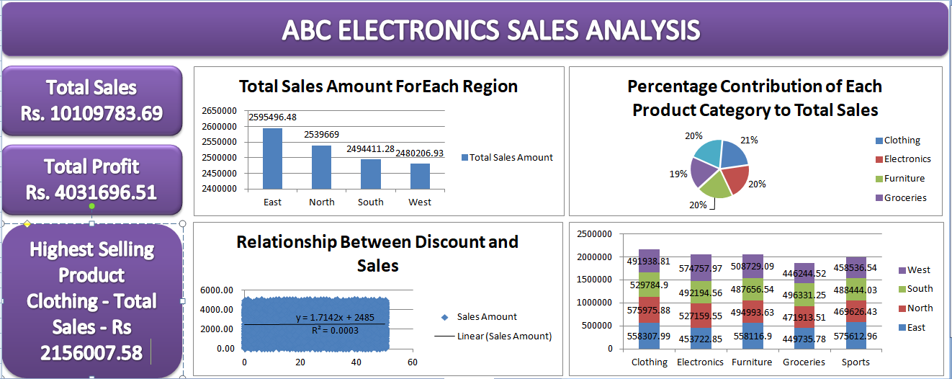
Task 9 – basic dashboard in excel

Slide 11
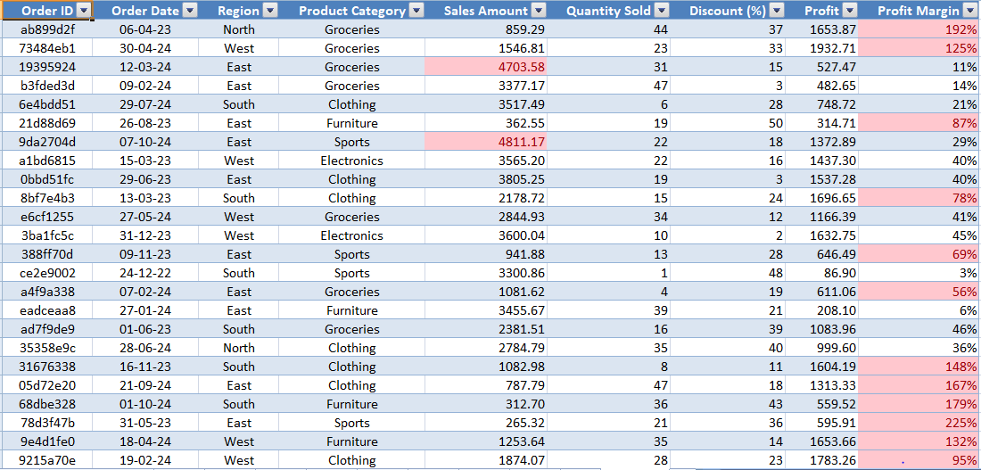
Task 10 – highlight high performers
Using conditional formatting, profit margin greater than 50% or sales amount greater than Rs 4000 is highlighted in color from other dataset.

